Slide 1


 | SILIGURI INSTITUTE OF TECHNOLOGY DEPARTMENT OF ELECTRICAL ENGINEERING
FOOD DELIVERY WEBSITE
BACHELOR OF TECHNOLOGY IN ELECTRICAL ENGINEERING
By
SOURADIP DAS[11901620007]

Slide 2

TOPICS
Introduction
Goal Of the project
Software Requirement Specifications Features
Screenshots
Future Goals
Acknowledgement

Slide 3
INTRODUCTION
Web development usually refers to developing the website, also known as web programming.
Creation of dynamic web application .
There are two main division of web development.
Front-end development(also called client-side development).
Back-end development(also called server-side development).
Front-end web development, also known as client-side development is the practice of producing HTML, CSS
and JAVASCRIPT for a website or web application so that a user can see and interact with them directly .
The objective of designing a site is to ensure that when the users open up the site they see the information
In a format that is easy to read and relevant.
Front-end technologies are : HTML , CSS , JAVASCRIPT

Slide 4
GOAL OF THE PROJECT
The goal of our project is to design an user interface or frontend of a food delivery website. Like other food delivery
Website for example :- DOMINOZ, PIZZAHUT . The frontend or the user interface should be user friendly and attractive.
The frontend will consist of a navigation bar,landing page, menu section and a section to place order. It will also
Consist of a section which will highlight about the services provided to the customer by the Pizza Delivery Company.

Slide 5
SOFTWARE REQUIREMENT
SOFTWARE:
Operating System :-
Windows 10
MAC OS
Linux
Web Browser
Internet Explorer
Google chrome
Mozilla fireFox
All web browsers i.e. supported by javascript
Hardware:
CPU core to dual core
HDD-256 GB
RAM 1GB (minimum)

Slide 6
FEATURES :-
Navigation Bar :-The website consists of a navigation bar which will help us to navigate to different sections of the website.
It consists of an eye pleasing landing Page.
Menu Section :- The website will consist of a menu section which will show the variety of pizzas available.
Service Section :- The website consists of a service section which will show the services provided to its customer by the
Company.
Order Section :- Here we can place our order.
Lastly the website has a footer section.

Slide 7
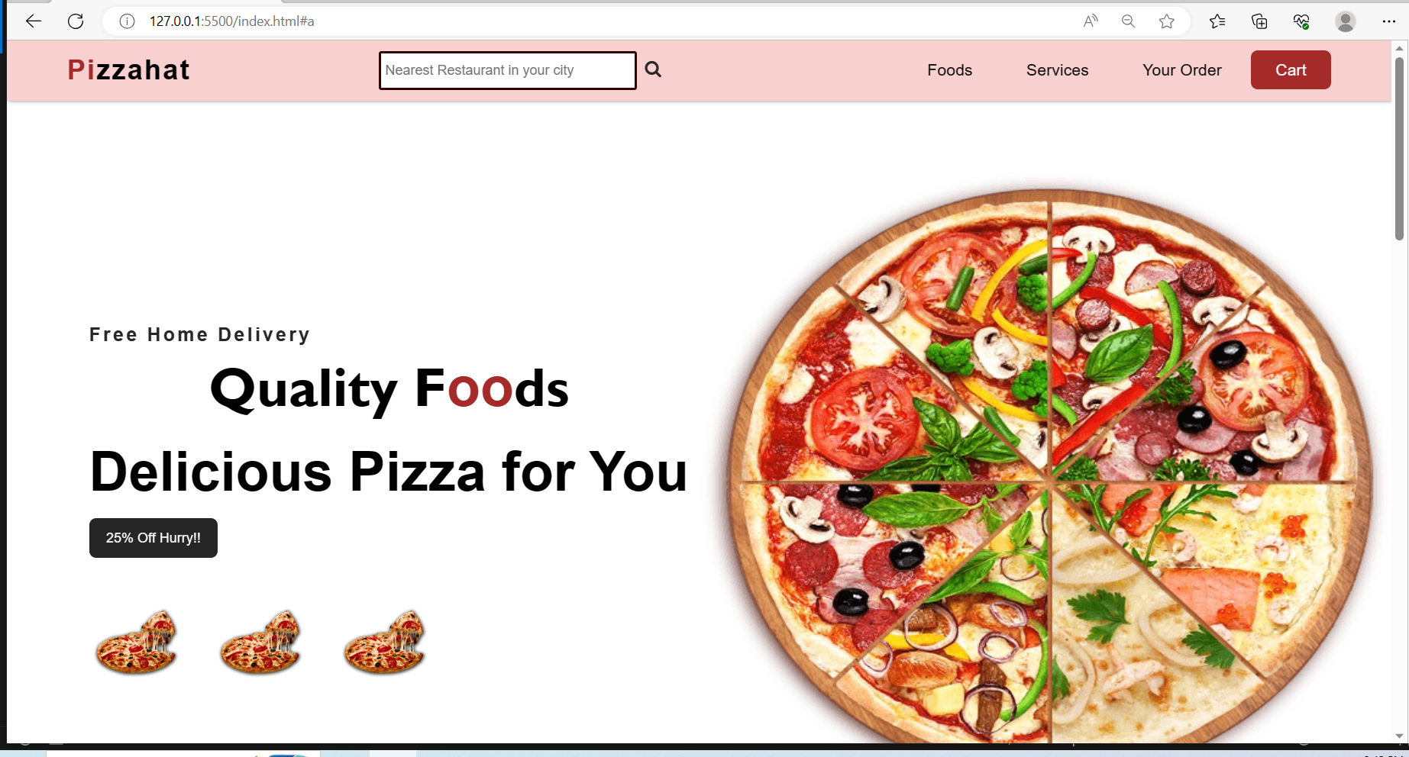
SCREEN-SHOTS

Slide 8
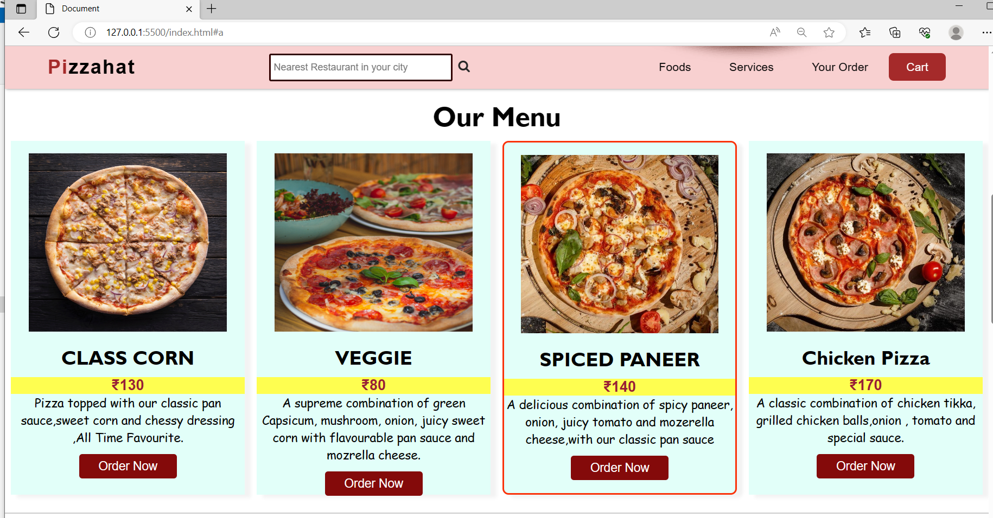

Slide 9
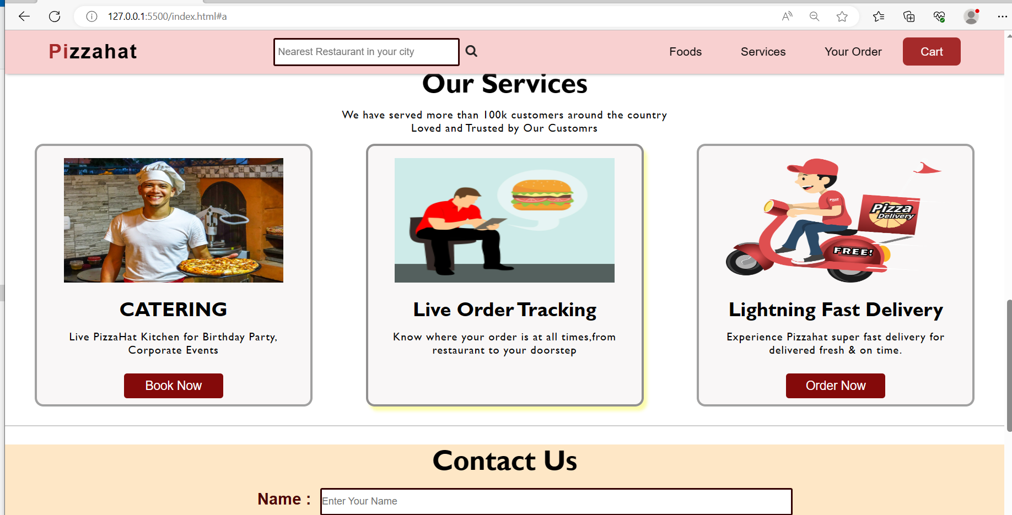
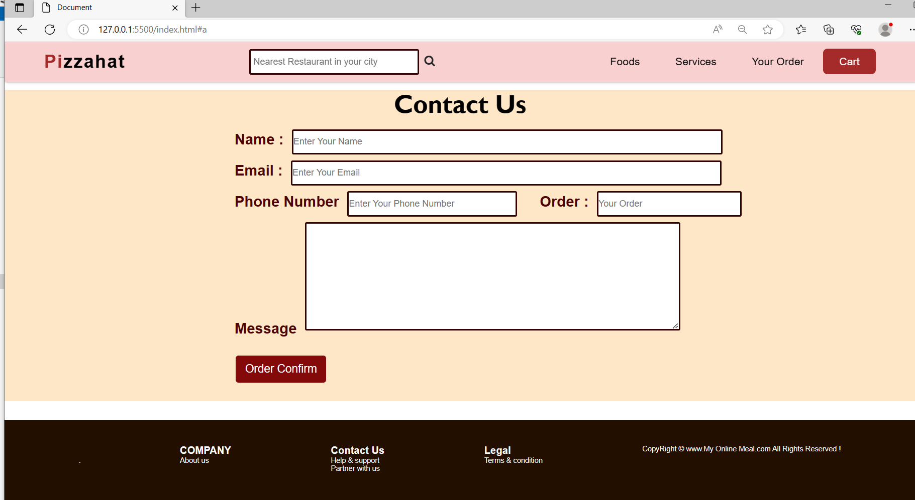

Slide 10
FUTURE GOALS :
I am always keep trying to improve my website and make it more user friendly.
Future work would involve providing a sign-up page and personalized dashboard to the user.It will help the user to keep track of the orders placed by him/her. The sign-up page will consist of
Username, E-mail, Password

Slide 11
ACKNOWLEDGEMENT
I would like to express my deep sense of gratitude and convey thanks to everyone who helped me and supported
during completion of this project. I acknowledge my department for providing the courses and a great atmosphere
that helped me to complete the project. I would like express my gratitude towards my Parents & Teachers
for their kind cooperation and encouragement which helped me in completion of this project.

